Slide 1
Hidden Variables, the EM Algorithm, and Mixtures of Gaussians
02/22/11
Computer Vision
CS 543 / ECE 549
University of Illinois
Derek Hoiem

Slide 2
HW 1 is graded
Mean = 93, Median = 98
A few comments
Diffuse component for estimating light color
Make sure to choose an appropriate size filter
Comparing frequencies for images at multiple scales
Wide variety of interesting apps
Maybe some would make good final project?

Slide 3
HW 1: Estimating Camera/Building Height

Slide 4
Today’s Class
Examples of Missing Data Problems
Detecting outliers
Latent topic models (HW 2, problem 3)
Segmentation (HW 2, problem 4)
Background
Maximum Likelihood Estimation
Probabilistic Inference
Dealing with “Hidden” Variables
EM algorithm, Mixture of Gaussians
Hard EM

Slide 5
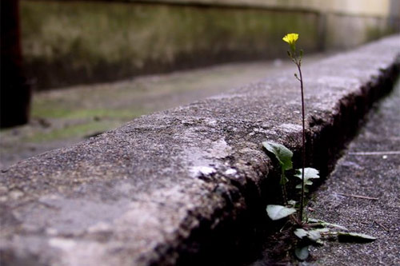
Missing Data Problems: Outliers
You want to train an algorithm to predict whether a photograph is attractive. You collect annotations from Mechanical Turk. Some annotators try to give accurate ratings, but others answer randomly.
Challenge: Determine which people to trust and the average rating by accurate annotators.
Annotator Ratings
10
8
9
2
8
Photo: Jam343 (Flickr)

Slide 6
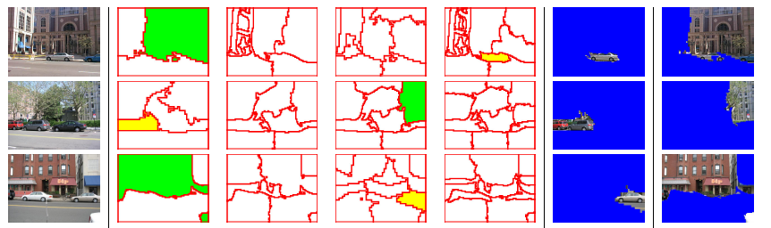
Missing Data Problems: Object Discovery
You have a collection of images and have extracted regions from them. Each is represented by a histogram of “visual words”.
Challenge: Discover frequently occurring object categories, without pre-trained appearance models.
http://www.robots.ox.ac.uk/~vgg/publications/papers/russell06.pdf

Slide 7

Missing Data Problems: Segmentation
You are given an image and want to assign foreground/background pixels.
Challenge: Segment the image into figure and ground without knowing what the foreground looks like in advance.
Foreground
Background

Slide 8
Missing Data Problems: Segmentation
Challenge: Segment the image into figure and ground without knowing what the foreground looks like in advance.
Three steps:
If we had labels, how could we model the appearance of foreground and background?
Once we have modeled the fg/bg appearance, how do we compute the likelihood that a pixel is foreground?
How can we get both labels and appearance models at once?
Background
Foreground

Slide 9
Maximum Likelihood Estimation
If we had labels, how could we model the appearance of foreground and background?
Background
Foreground

Slide 10
Maximum Likelihood Estimation
data
parameters

Slide 11
Maximum Likelihood Estimation
Gaussian Distribution
Notes:
Assume data is i.i.d. and solve using partial derivatives.

Slide 12
Maximum Likelihood Estimation
Gaussian Distribution

Slide 13


Example: MLE
Parameters used to Generate
fg: mu=0.6, sigma=0.1
bg: mu=0.4, sigma=0.1
im
labels
>> mu_fg = mean(im(labels))
mu_fg = 0.6012
>> sigma_fg = sqrt(mean((im(labels)-mu_fg).^2))
sigma_fg = 0.1007
>> mu_bg = mean(im(~labels))
mu_bg = 0.4007
>> sigma_bg = sqrt(mean((im(~labels)-mu_bg).^2))
sigma_bg = 0.1007
>> pfg = mean(labels(:));

Slide 14
Probabilistic Inference
2. Once we have modeled the fg/bg appearance, how do we compute the likelihood that a pixel is foreground?
Background
Foreground

Slide 15
Probabilistic Inference
Compute the likelihood that a particular model generated a sample
component or label

Slide 16
Probabilistic Inference
Compute the likelihood that a particular model generated a sample
component or label

Slide 17
Probabilistic Inference
Compute the likelihood that a particular model generated a sample
component or label

Slide 18
Probabilistic Inference
Compute the likelihood that a particular model generated a sample
component or label

Slide 19

Example: Inference
Learned Parameters
fg: mu=0.6, sigma=0.1
bg: mu=0.4, sigma=0.1
im
>> pfg = 0.5;
>> px_fg = normpdf(im, mu_fg, sigma_fg);
>> px_bg = normpdf(im, mu_bg, sigma_bg);
>> pfg_x = px_fg*pfg ./ (px_fg*pfg + px_bg*(1-pfg));
p(fg | im)

Slide 20
Dealing with Hidden Variables
3. How can we get both labels and appearance models at once?
Background
Foreground

Slide 21
Mixture of Gaussians
mixture component
component model parameters
component prior

Slide 22
Mixture of Gaussians
With enough components, can represent any probability density function
Widely used as general purpose pdf estimator

Slide 23
Segmentation with Mixture of Gaussians
Pixels come from one of several Gaussian components
We don’t know which pixels come from which components
We don’t know the parameters for the components

Slide 24
Simple solution
Initialize parameters
Compute the probability of each hidden variable given the current parameters
Compute new parameters for each model, weighted by likelihood of hidden variables
Repeat 2-3 until convergence

Slide 25
Mixture of Gaussians: Simple Solution
Initialize parameters
Compute likelihood of hidden variables for current parameters
Estimate new parameters for each model, weighted by likelihood

Slide 26
Expectation Maximization (EM) Algorithm
Goal:
Log of sums is intractable
Jensen’s Inequality
for concave funcions, such as f(x)=log(x)
See here for proof: www.stanford.edu/class/cs229/notes/cs229-notes8.ps

Slide 27
Expectation Maximization (EM) Algorithm
Goal:
E-step: compute
M-step: solve

Slide 28
EM for Mixture of Gaussians (on board)
E-step:
M-step:

Slide 29
EM for Mixture of Gaussians (on board)
E-step:
M-step:

Slide 30
EM Algorithm
Maximizes a lower bound on the data likelihood at each iteration
Each step increases the data likelihood
Converges to local maximum
Common tricks to derivation
Find terms that sum or integrate to 1
Lagrange multiplier to deal with constraints

Slide 31
EM Demos
Mixture of Gaussian demo
Simple segmentation demo

Slide 32
“Hard EM”
Same as EM except compute z* as most likely values for hidden variables
K-means is an example
Advantages
Simpler: can be applied when cannot derive EM
Sometimes works better if you want to make hard predictions at the end
But
Generally, pdf parameters are not as accurate as EM

Slide 33
Missing Data Problems: Outliers
You want to train an algorithm to predict whether a photograph is attractive. You collect annotations from Mechanical Turk. Some annotators try to give accurate ratings, but others answer randomly.
Challenge: Determine which people to trust and the average rating by accurate annotators.
Annotator Ratings
10
8
9
2
8
Photo: Jam343 (Flickr)

Slide 34
Missing Data Problems: Object Discovery
You have a collection of images and have extracted regions from them. Each is represented by a histogram of “visual words”.
Challenge: Discover frequently occurring object categories, without pre-trained appearance models.
http://www.robots.ox.ac.uk/~vgg/publications/papers/russell06.pdf

Slide 35
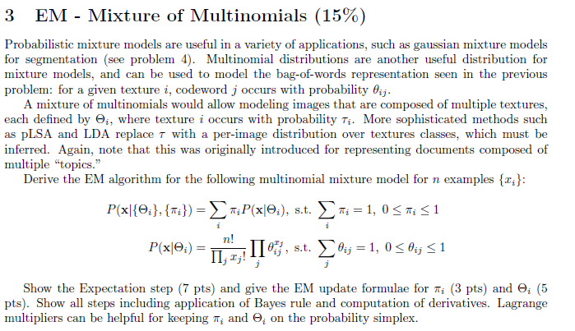
n is number of elements in histogram

Slide 36
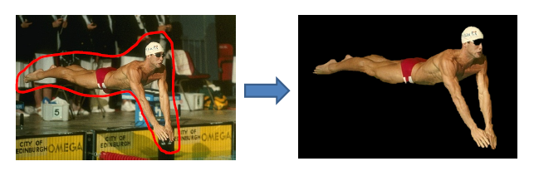
Next class
MRFs and Graph-cut Segmentation

Slide 37
Missing data problems
Outlier Detection
You expect that some of the data are valid points and some are outliers but…
You don’t know which are inliers
You don’t know the parameters of the distribution of inliers
Modeling probability densities
You expect that most of the colors within a region come from one of a few normally distributed sources but…
You don’t know which source each pixel comes from
You don’t know the Gaussian means or covariances
Discovering patterns or “topics”
You expect that there are some re-occuring “topics” of codewords within an image collection. You want to…
Figure out the frequency of each codeword within each topic
Figure out which topic each image belongs to

Slide 38
Running Example: Segmentation
Given examples of foreground and background
Estimate distribution parameters
Perform inference
Knowing that foreground and background are “normally distributed”
Some initial estimate, but no good knowledge of foreground and background

